Slide 1
Azure Data Warehouse In-A-Day 04.SQL DW Operational best practices
Steve Young - Data & AI CSA
Rebecca Young - Data & AI CSA

Slide 2
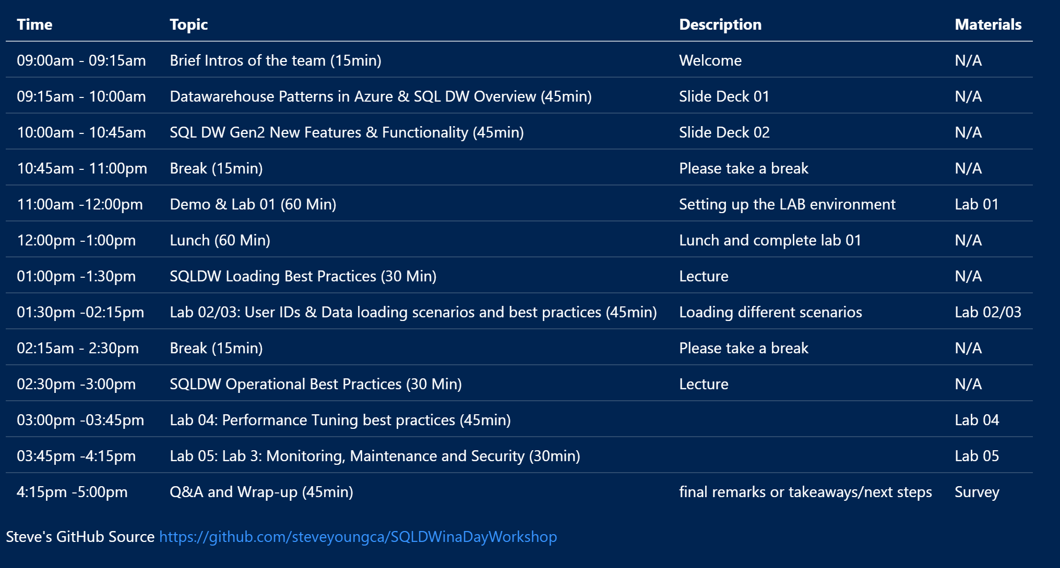
Agenda - TBD
Notes:
Quickly go through Test Cases to refresh everyone and relate them to agenda topics for the day

Slide 3
Important Info
WIFI -
PWD –
File Location - https://github.com/steveyoungca/SQLDWinaDayWorkshop

Slide 4
SQL DW Operational best practices

Slide 5
Topics
Data Movement
Replicated Tables
Concurrency, Concurrency Slots and Resource Classes
Index/Stats
Monitoring

Slide 6
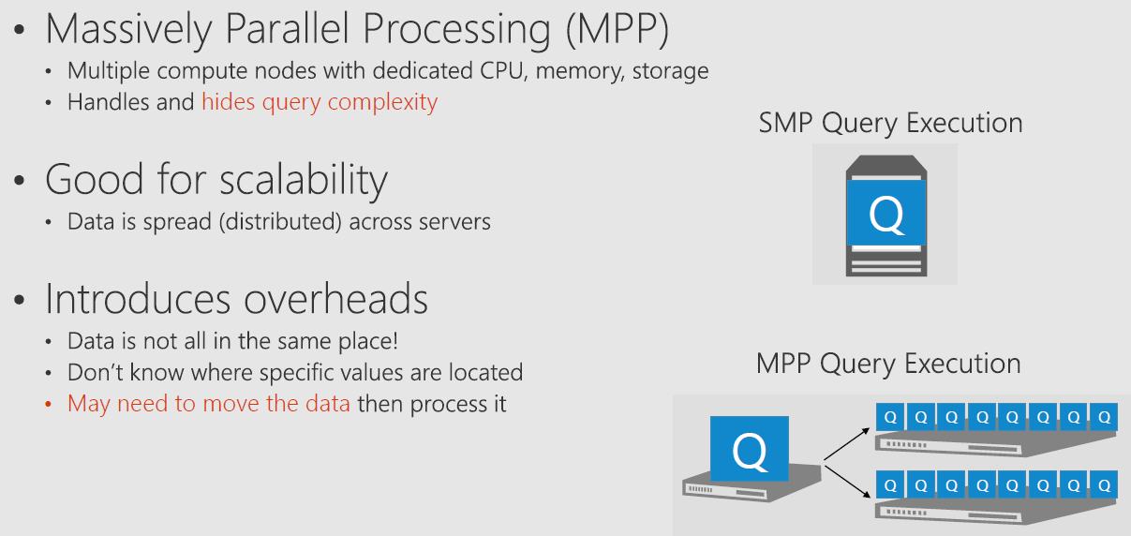
Data and Compute are Distributed

Slide 7
Data Movement

Slide 8
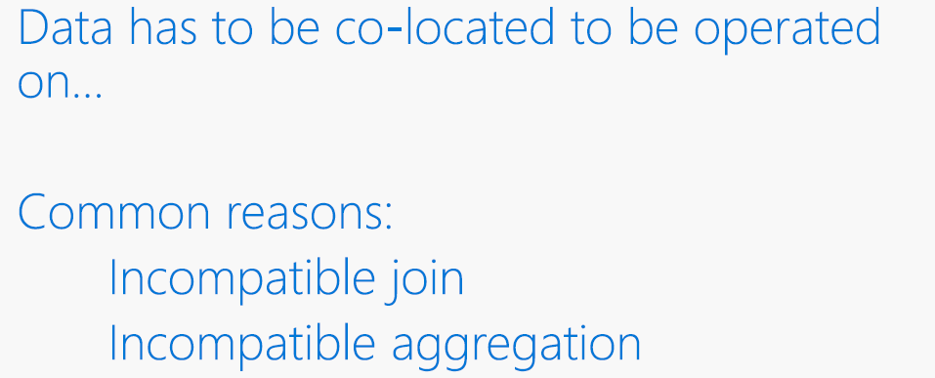
Why Data Moves

Slide 9
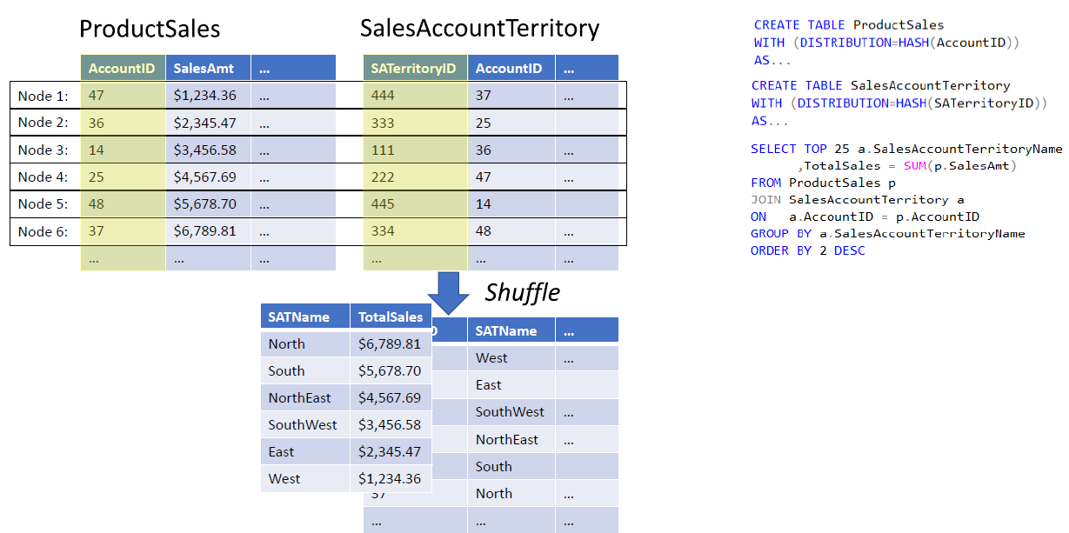
Distributed Data Movement

Slide 10
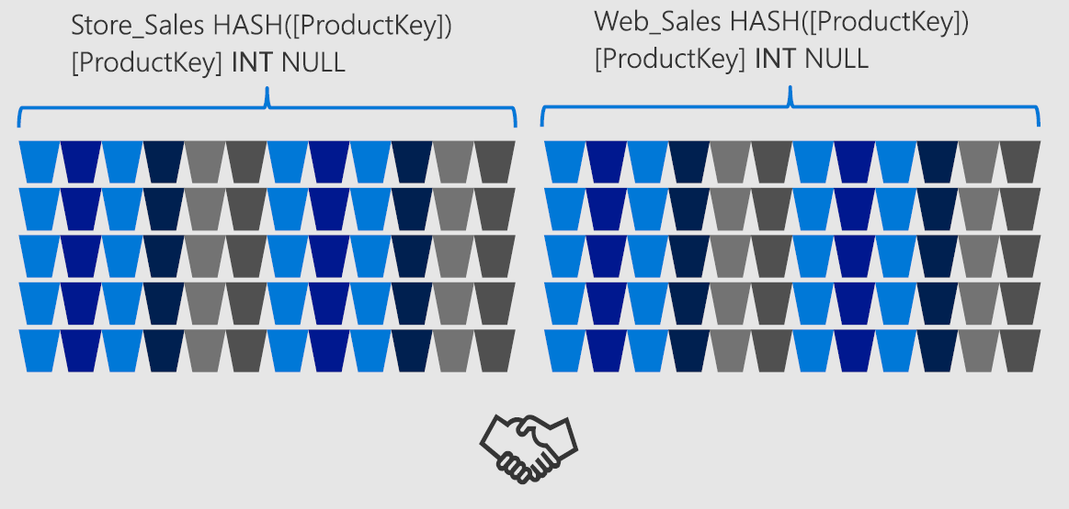
Joining HASH tables

Slide 11
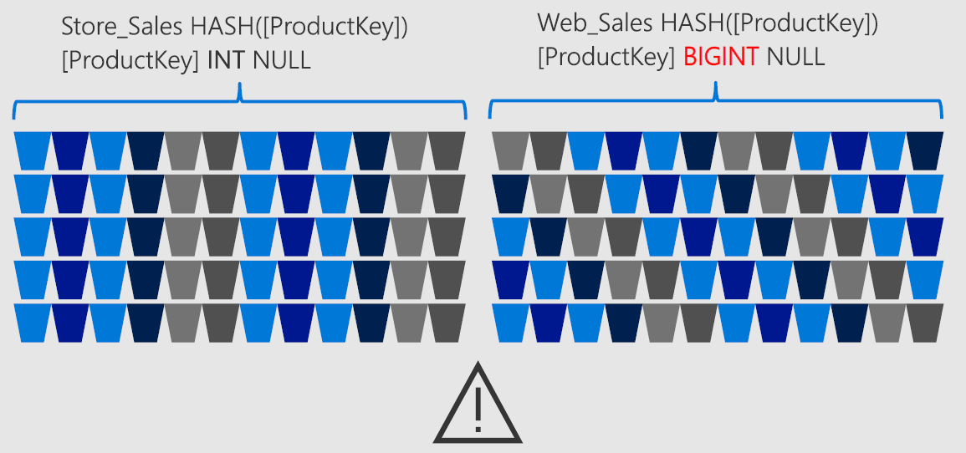
Joining HASH tables

Slide 12
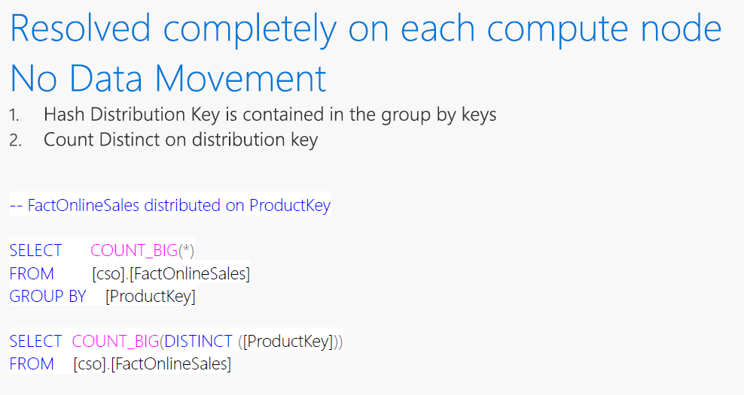
Aggregation - Compatible

Slide 13
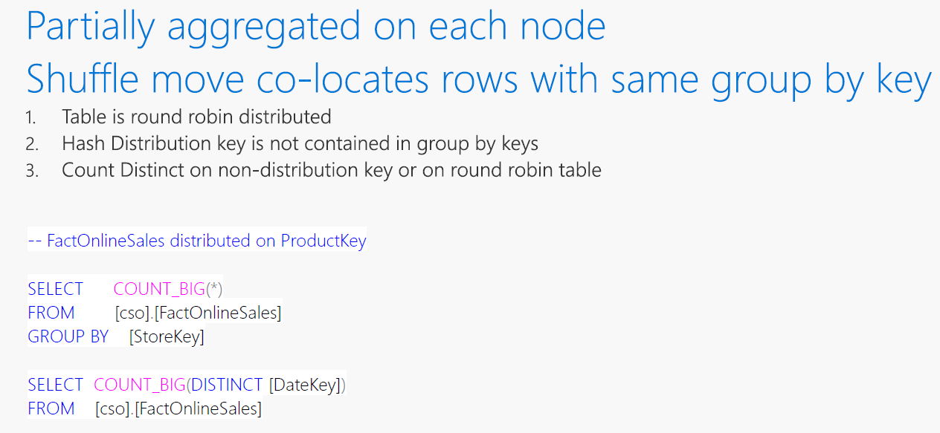
Aggregation - InCompatible

Slide 14
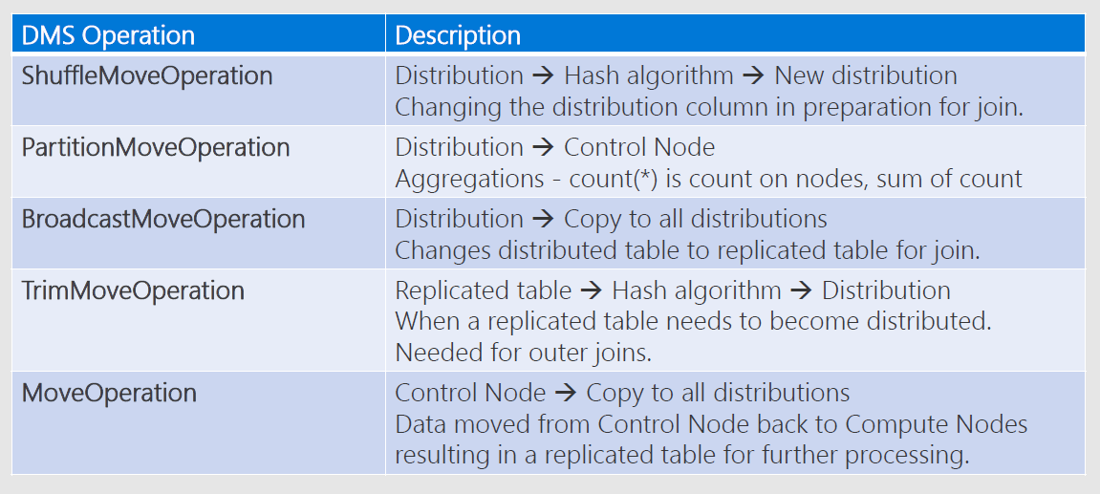
Data Movement Types for a Query

Slide 15
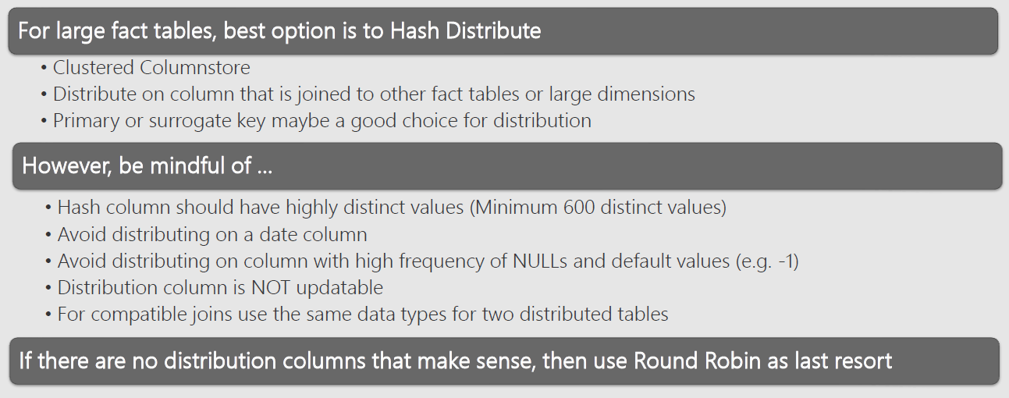
Distribution Guidance

Slide 16

Skewed Distribution

Slide 17
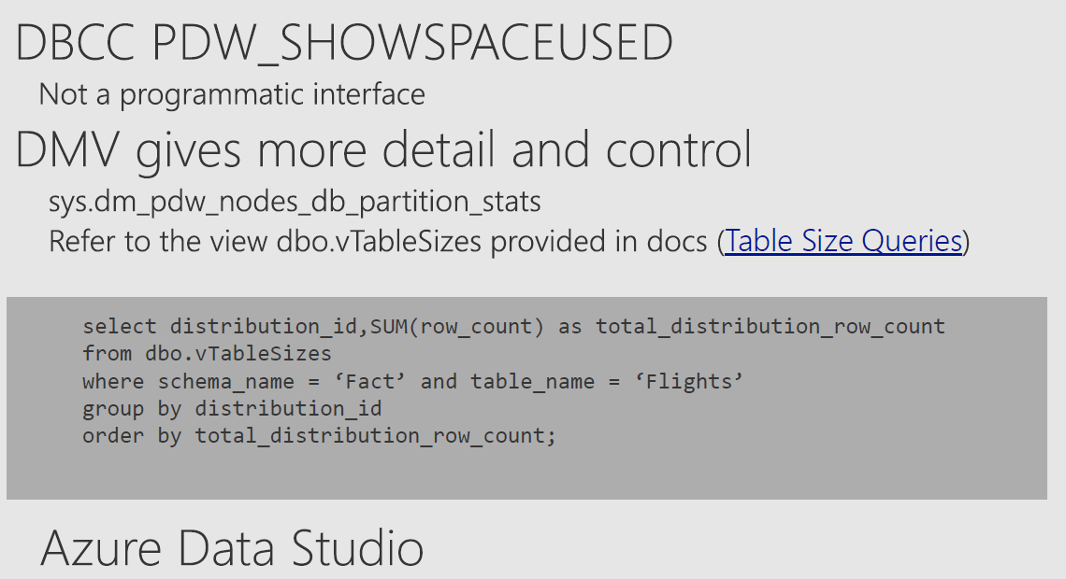
Finding Skew

Slide 18
Replicated Tables

Slide 19
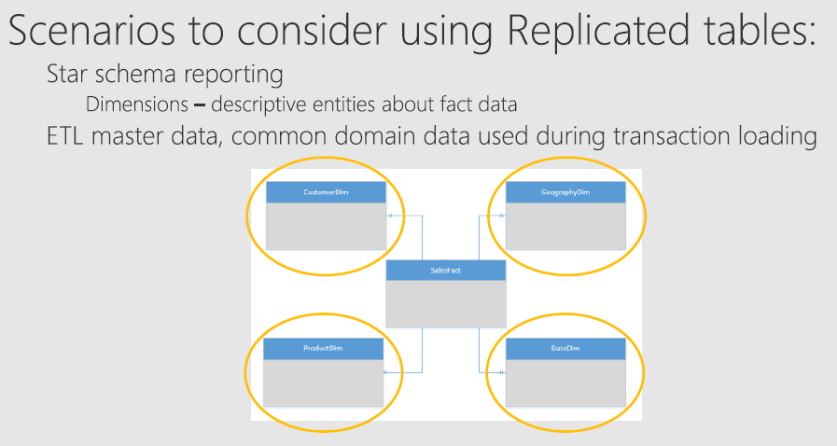
Replicated Tables Scenarios

Slide 20
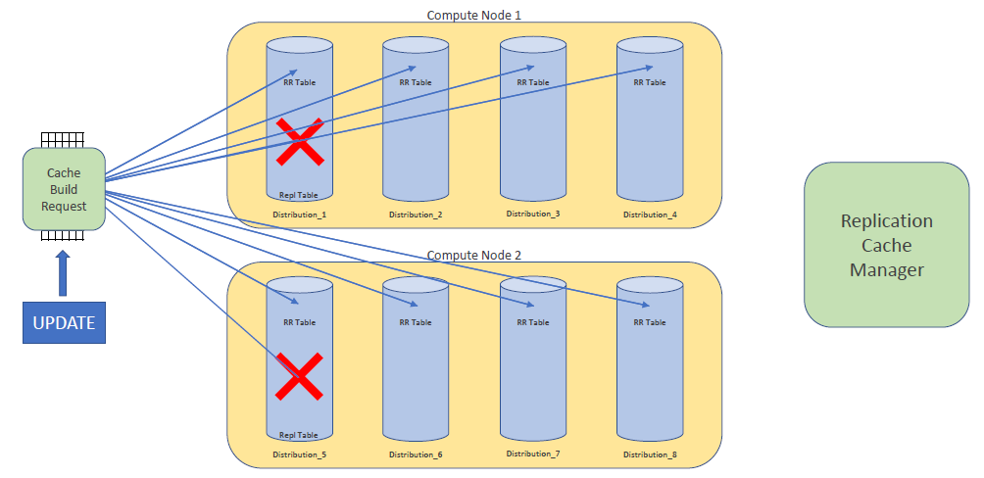
Replicated Tables .. How it works

Slide 21
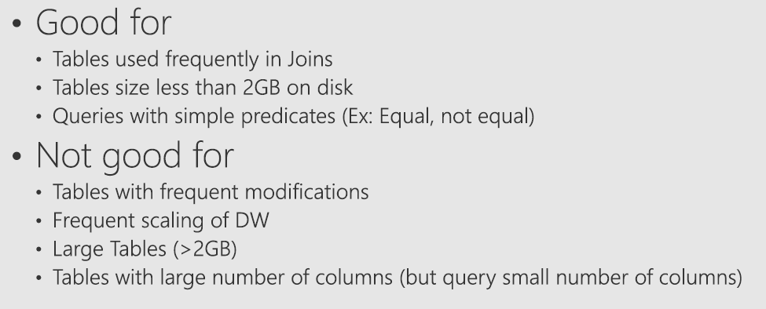
Replicated Tables Best Practices

Slide 22
Concurrency, Concurrency Slots and Resource Classes

Slide 23
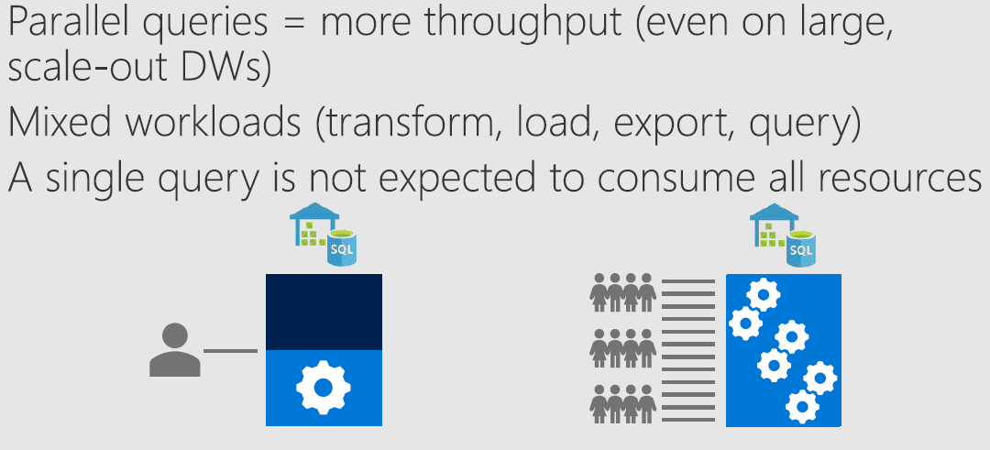
Importance of Concurrency

Slide 24
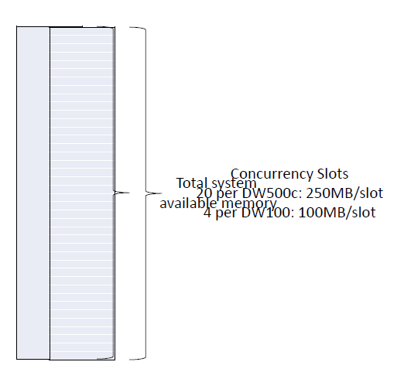
Concurrency Slots
Get a better slide

Slide 25
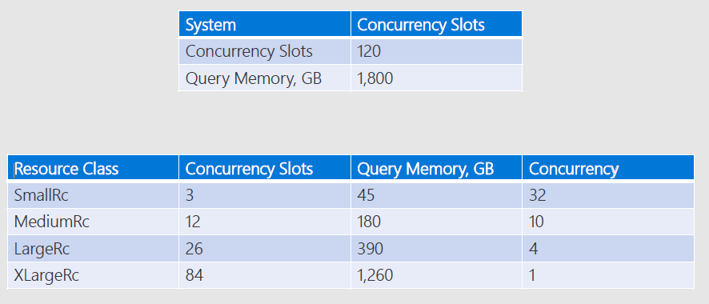
Dynamic Resource Class Example at DW3000c

Slide 26
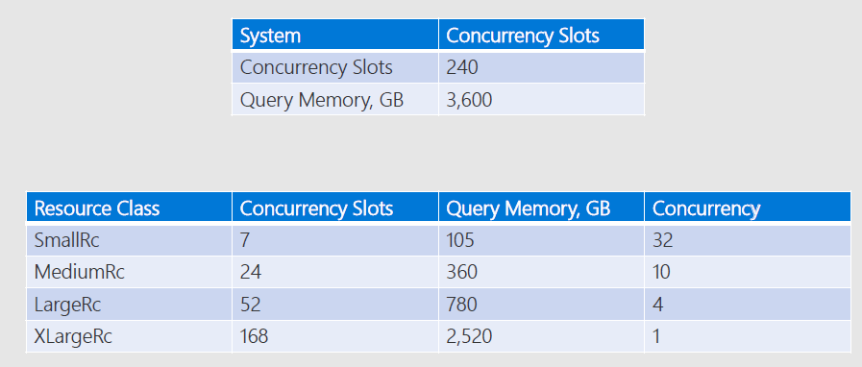
Dynamic Resource Class Example at DW6000c

Slide 27
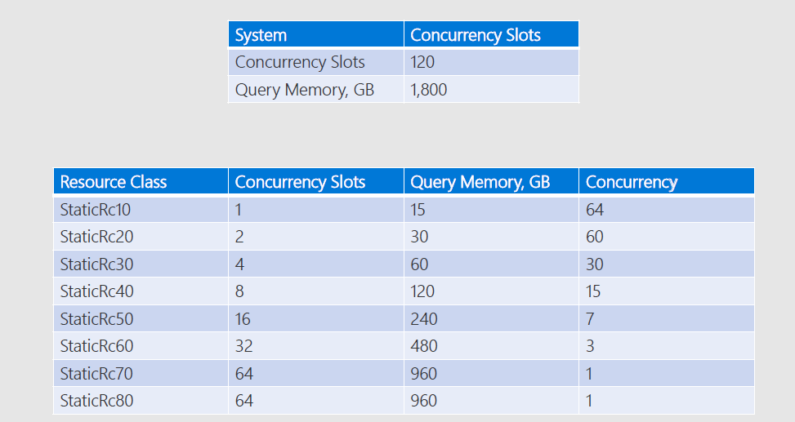
Static Resource Class Example at DW3000c

Slide 28
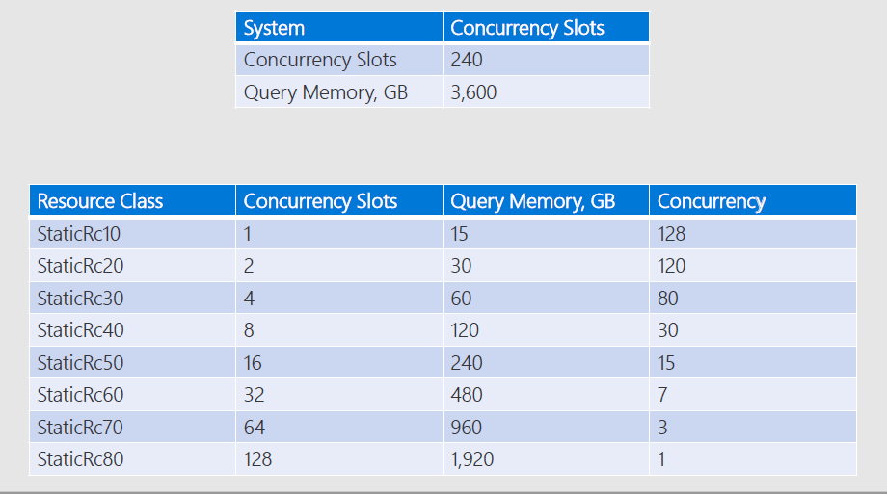
Static Resource Class Example at DW6000c

Slide 29
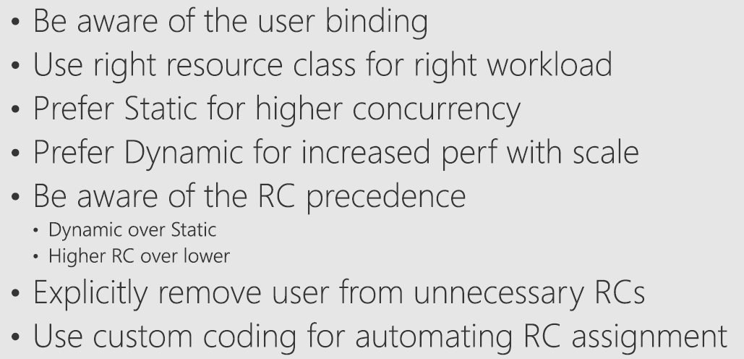
Resource Class Best Practices

Slide 30
Index/Stats

Slide 31
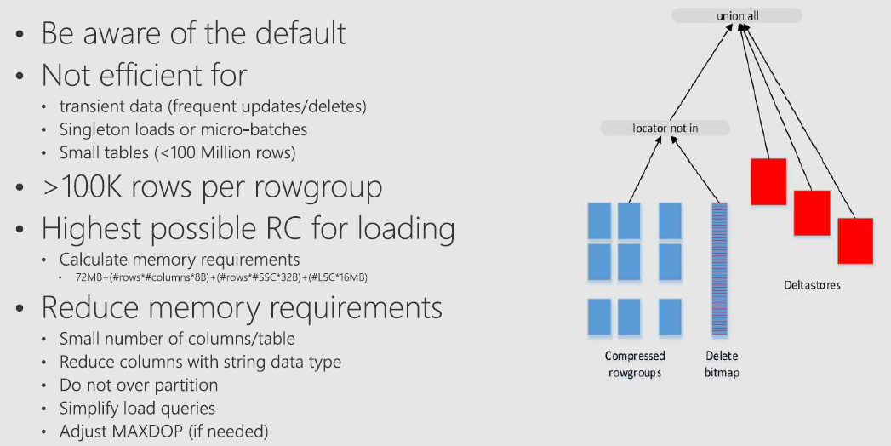
Clustered Columnstore Indexes(CCI) Best Practices
https://docs.microsoft.com/en-us/azure/sql-data-warehouse/sql-data-warehouse-tables-index

Slide 32
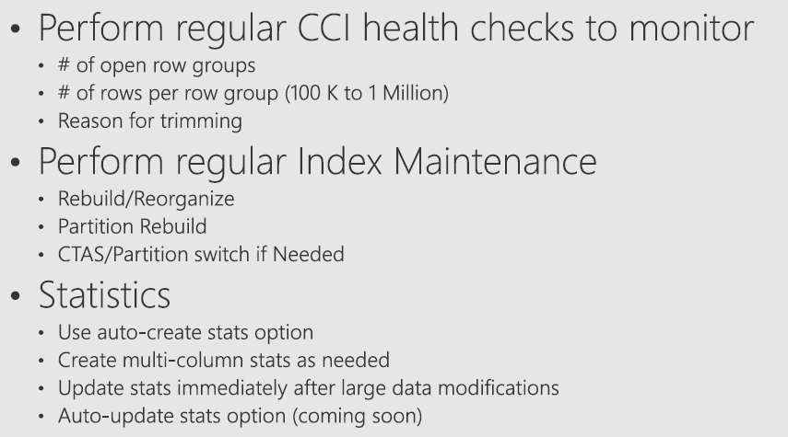
Index/Stats Best Practices

Slide 33
Monitoring

Slide 34
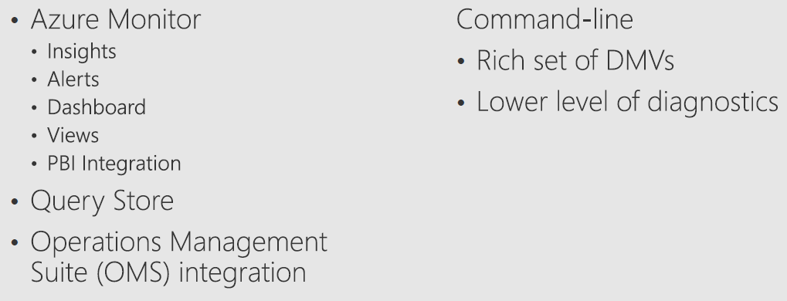
Monitoring Options

Slide 35
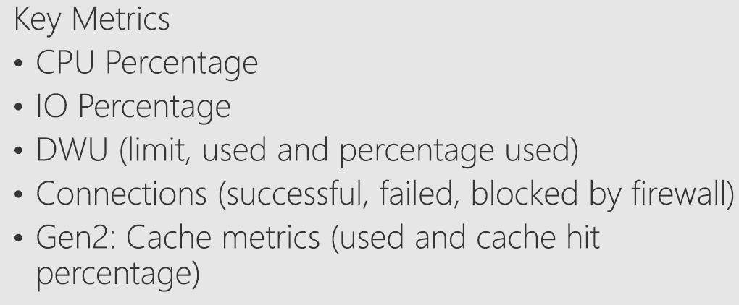
Azure Portal
Notes:
Love to demo this, show in the portal

Slide 36
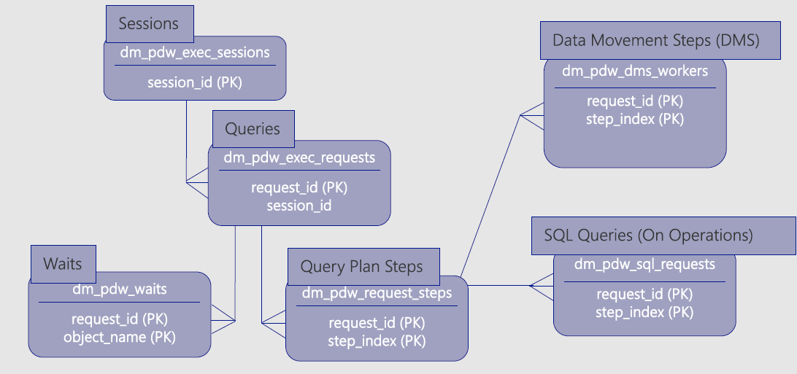
Execution DMVs

Slide 37
Additional Resources
SQL Data Warehouse Documentation - https://docs.microsoft.com/en-us/azure/sql-data-warehouse/

Slide 38
Q&A

